Slide 1
Child Tax Credits - Nonrefundable Additional CTC – Refundable
Pub 4012 Tabs G
Pub 17 Chapter 47
(Federal 1040-Lines 52 & 67)
Notes:
1

Slide 2
Child Tax Credit (CTC)
Pub 4012 Tab G
Nonrefundable credit
Maximum credit per qualified child - $1,000
General Requirements:
Must meet Qualifying Child criteria
AGI & Filing Status determines amount, if any, of credit
“CTC” box opposite dependent’s name on Main Information Sheet checked automatically by TW
Use TW link to Child Tax Credit worksheet (wkt 3)– TW will automatically calculate credit and transfers to 1040 line 52
Notes:
Note: There is also an Additional Child Tax Credit - a refundable credit
2

Slide 3
Child Tax Credit Qualifying Child Criteria
Pub 4012 Tab G
Claimed as taxpayer dependent:
Own child, step, adopted or foster child, or their descendants
Siblings, step brother/sister , half brother/sister or their descendants
Age: Under 17 on December 31 of tax year
Residency: lived with taxpayer over 6 months (exceptions discussed next)
Support: Child provided less than 50% of own support
US citizen or resident of US
Notes:
3

Slide 4
Exceptions To Residency
Born/died during tax year & lived with you for entire time he/she was alive
Temporary absences count as time lived at home – school, military, vacations, etc.
Children of divorced/separated parents:
See special rules in Pub 4012 Tab G
Notes:
4

Slide 5
Additional CTC Tax Credit
Refundable Tax Credit
Applicable for taxpayers who get less than full CTC (tax liability less than allowable CTC)
Must have > $3,000 of taxable earned income to be eligible (unless have 3 or more children)
Limited to 15% of earned income above $3,000
TW will automatically insert Form 8812 for completion & calculation of Additional CTC, transfers to 1040 line 67
Form 8812
Part I – Applies to all filers
Part II – Applies to filers who have 3 or more qualifying children
Notes:
5

Slide 6
TW Tips
Child Tax Credit is determined automatically by TW on 1040 Wkt 3, based on dependency & age
DO NOT override
TW transfers Child Tax Credit to 1040 Line 52
TW calculates Additional Child Tax Credit on Form 8812
TW transfers Additional Child Tax Credit to 1040 Line 67
Notes:
6

Slide 7
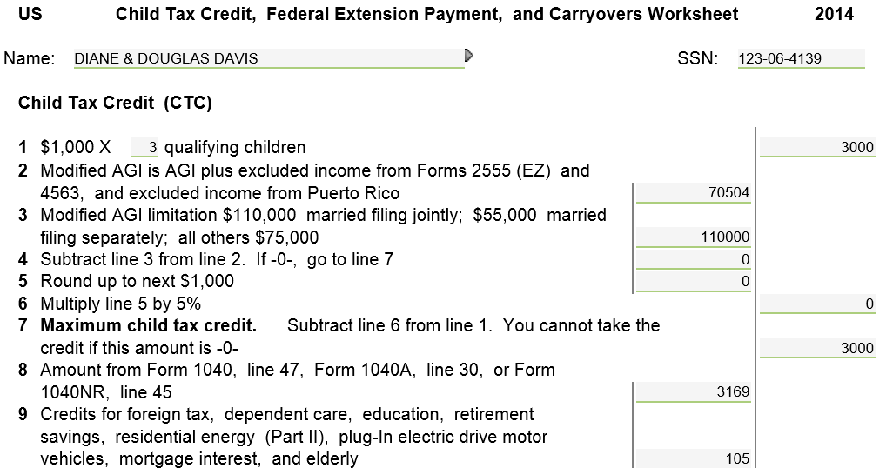
TW Child Tax Credit – Federal 1040 Wkt 3
TW calculates this Worksheet automatically
Notes:
Sample 1040 WKt 3 for the Child Tax Credit
1040 Worksheet 3 Line 7 shows the maximum CTC. However, since CTC is non-refundable, can only claim the amount of tax liability left after all earlier non-refundable credits on 1040 have been taken. Therefore, the claimed CTC may be less than maximum or even 0
TW automatically completes this worksheet & transfers the total on Line 11 to 1040 Line 51
7

Slide 8
TW Child Tax Credit – Federal 1040 Line 52
Total tax liability
TW transfers from 1040 Wkt 3 Line 11
Total nonrefundable credits do not
exceed tax liability
Notes:
TW transfers 1040 Wkt 3 Line 11 to 1040 Line 52
Notice that total of all nonrefundable credits (not just Child Tax Credit) on 1040 Line 56 cannot exceed total tax liability on Line 47
8

Slide 9
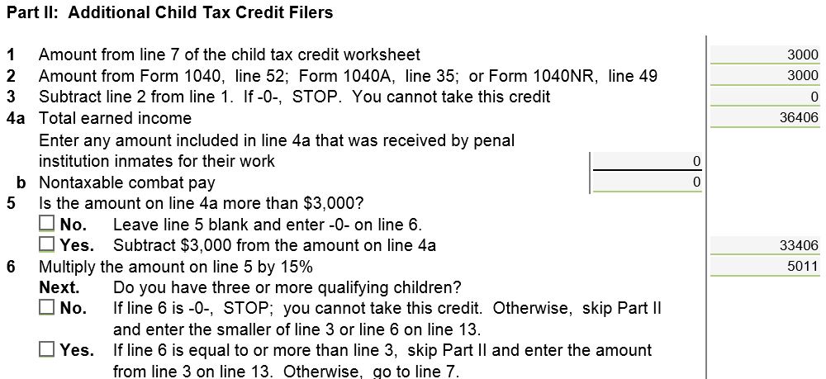
TW Additional Child Tax Credit – Form 8812 Page 1
If not eligible for full Nonrefundable Child Tax Credit (not enough remaining tax liability), TW will calculate Additional Child Tax Credit on Form 8812
Notes:
Sample Form 8812 for the Additional Child Tax Credit. A family is not eligible for this credit if they received the maximum Child Tax Credit
TW automatically completes this worksheet
Total of Child Tax Credit + Additional Child Tax Credit cannot exceed $1,000 per child
9

Slide 10
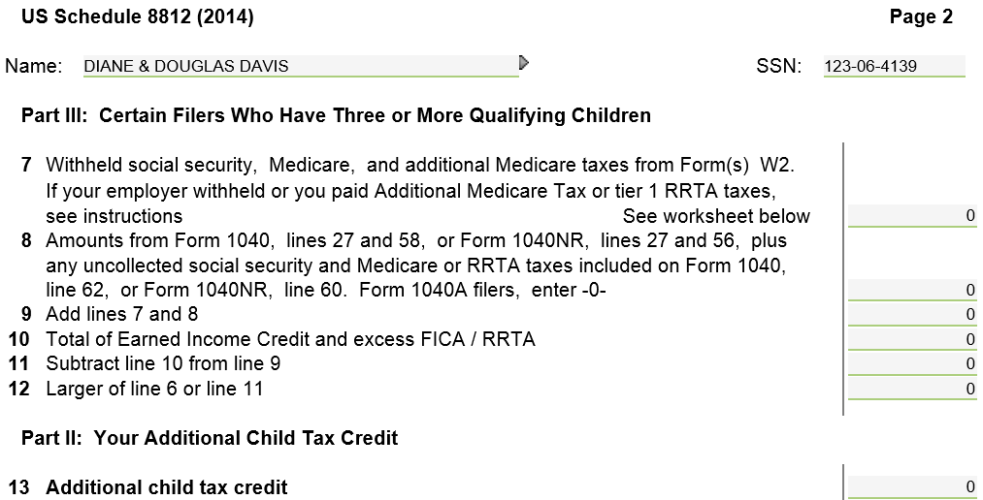
TW Additional Child Tax Credit - Form 8812 Page 2
Cannot claim Refundable Additional Child Tax Credit because
received full Nonrefundable Child Tax Credit
Notes:
10

Slide 11
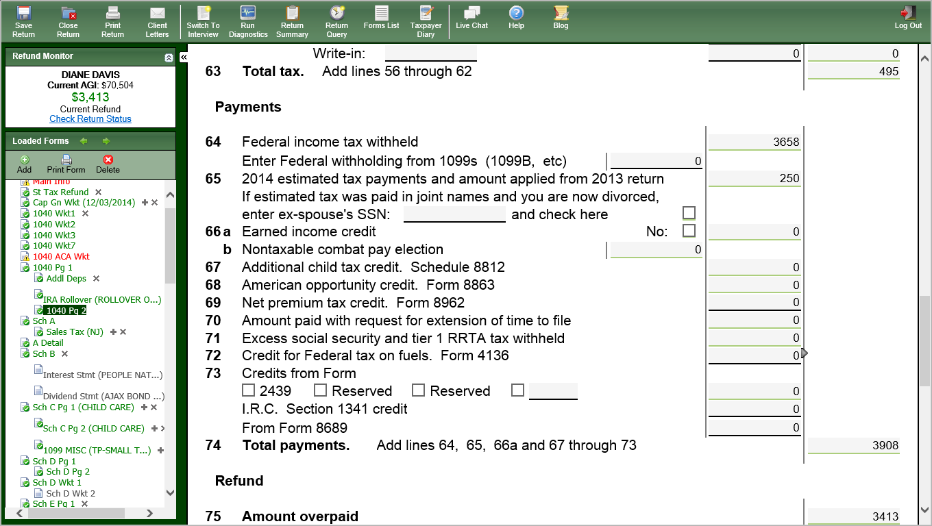
TW Additional Child Tax Credit – 1040 Line 67
TW transfers from Sch 8812 Line 13
Notes:
TW transfers Form 8812 Line 13 to 1040 Line 67
11

